Slide 1
The Oracle

Slide 2
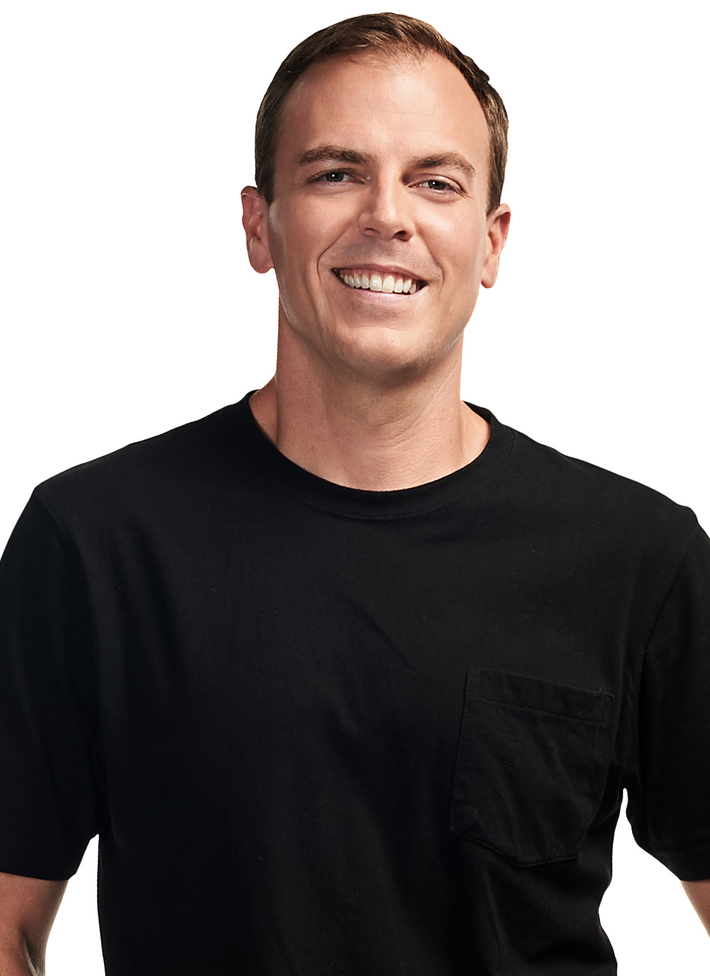
TEAM OVERVIEW
Everyone introduce themselves
Nicholas Solomos (Team Lead) - 24429488
Clement Dai (UI/UX Developer) - 12934992
Ramon Tovar (Frontend Developer) - 12918761
Peicheng Guo (Tester/QA and Business Analyst) - 13755020
Jiguang Wen (Backend Developer) - 14347328
Jiahui Su (Backend Developer) - 13720798
Zhiheng Gu (Business Analyst and Tester/QA) - 24901353
Notes:
Have to talk about client

Slide 3

Problem statement
NICK
There are too many whiskeys to review.
Each review is inherently subjective.
Let’s create a platform where we can find and review whiskeys based on their molecular structure and accompanying flavour notes.
Notes:
Whiskey tasting notes are inherently subjective, influenced by individual perceptions and vocabulary. Current platforms often offer limited tools to truly dissect flavor origins beyond broad categories.
The goal of this project is to address the lack of current platforms available that can allow whiskey enthusiasts to truly dissect flavor origins beyond broad categories. The ultimate objective of this project is to innovate on existing platforms by leveraging detailed chemical analysis data, which will enable users to explore and match whiskeys through an advanced, interactive search feature. This feature will present complex data (such as flavor compounds) in an intuitive, user-friendly interface, emphasizing a deep dive into the sensory attributes of whiskey in a visually engaging manner.

Slide 4

What’s the solution?
NICK
A platform for whiskey enthusiasts.
The ability to filter whiskeys based on region, flavour, brand, and compound flavour notes.
Visualise the strength of flavour notes.
Notes:
Whiskey tasting notes are inherently subjective, influenced by individual perceptions and vocabulary. Current platforms often offer limited tools to truly dissect flavor origins beyond broad categories.
The goal of this project is to address the lack of current platforms available that can allow whiskey enthusiasts to truly dissect flavor origins beyond broad categories. The ultimate objective of this project is to innovate on existing platforms by leveraging detailed chemical analysis data, which will enable users to explore and match whiskeys through an advanced, interactive search feature. This feature will present complex data (such as flavor compounds) in an intuitive, user-friendly interface, emphasizing a deep dive into the sensory attributes of whiskey in a visually engaging manner.

Slide 5


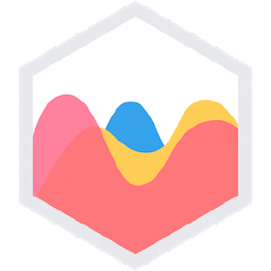
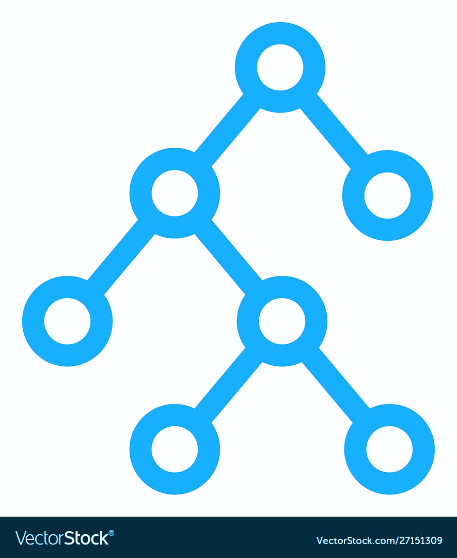


Technical stack
Ramon
Language | JavaScript, SQL, Python
Framework(s) and Libraries | React, Chart.js, Vite, Django
Communication | Discord
Design | Figma, Draw.io
Management Tools | Trello, Miro
Notes:
IN-SCOPE:
Radar graph; whiskey provided in dummy data;
OUT-SCOPE: Comment/discussion section; machine learning model to give recommendations; friends list; profile; login; ability to purchase whiskeys; ability to see price of whiskeys; like/dislike system

Slide 6

How does it work?
Ramon
Users can:
Upload various whiskeys and compounds
Leave reviews
Vote on the strength of flavours and compounds
Explore a catalogue of whiskeys and compounds
Interact with flavour visualisations to gain more information
Compare whiskey compositions
Notes:
Whiskey tasting notes are inherently subjective, influenced by individual perceptions and vocabulary. Current platforms often offer limited tools to truly dissect flavor origins beyond broad categories.
The goal of this project is to address the lack of current platforms available that can allow whiskey enthusiasts to truly dissect flavor origins beyond broad categories. The ultimate objective of this project is to innovate on existing platforms by leveraging detailed chemical analysis data, which will enable users to explore and match whiskeys through an advanced, interactive search feature. This feature will present complex data (such as flavor compounds) in an intuitive, user-friendly interface, emphasizing a deep dive into the sensory attributes of whiskey in a visually engaging manner.

Slide 7
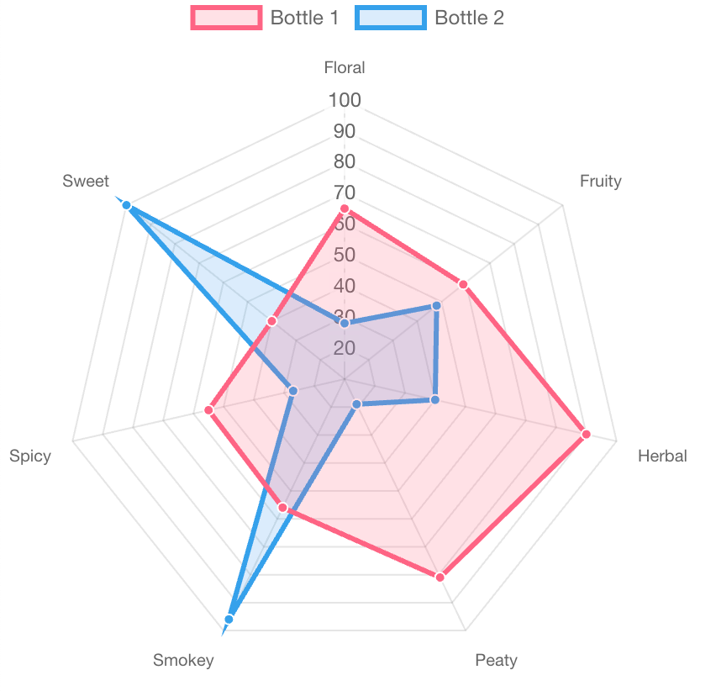
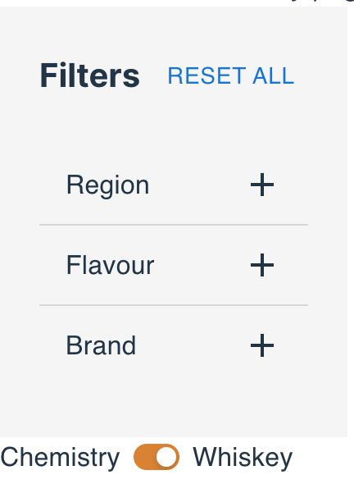
Product features
Clement
Interactive radar graph
Whiskey and compound filtering
Search
Compound information
Whiskey information
Notes:
IN-SCOPE:
Radar graph; whiskey provided in dummy data;
OUT-SCOPE: Comment/discussion section; machine learning model to give recommendations; friends list; profile; login; ability to purchase whiskeys; ability to see price of whiskeys; like/dislike system

Slide 8
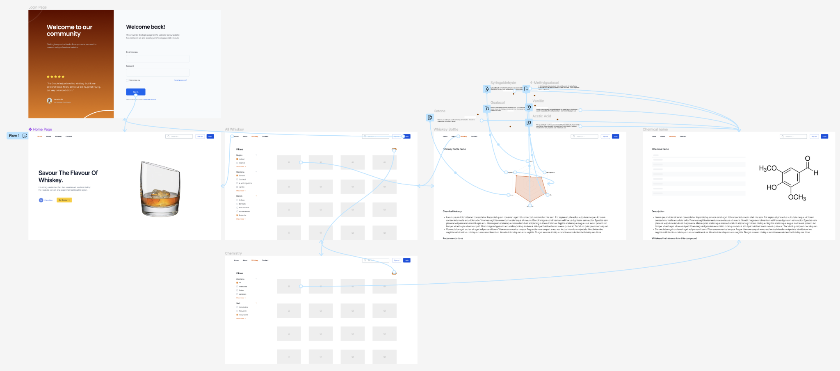
UI/UX
Clement
Figma
Front-end

Slide 9
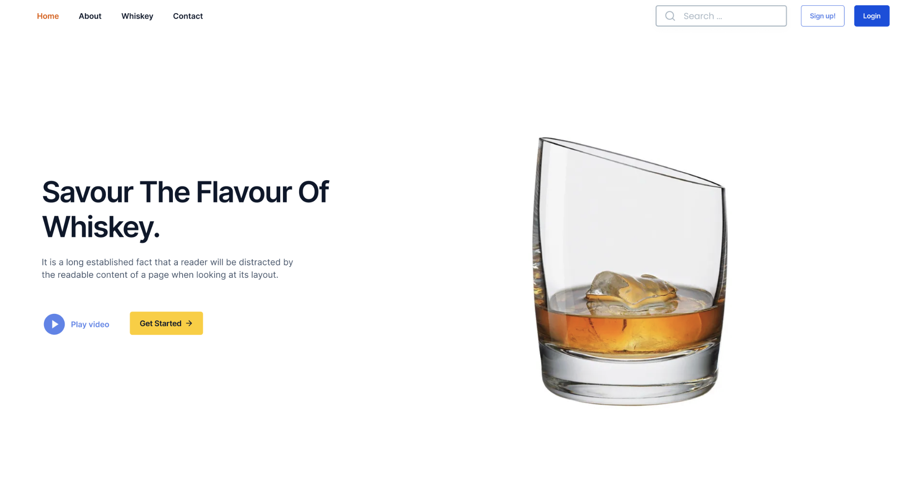
Homepage
Wen

Slide 10
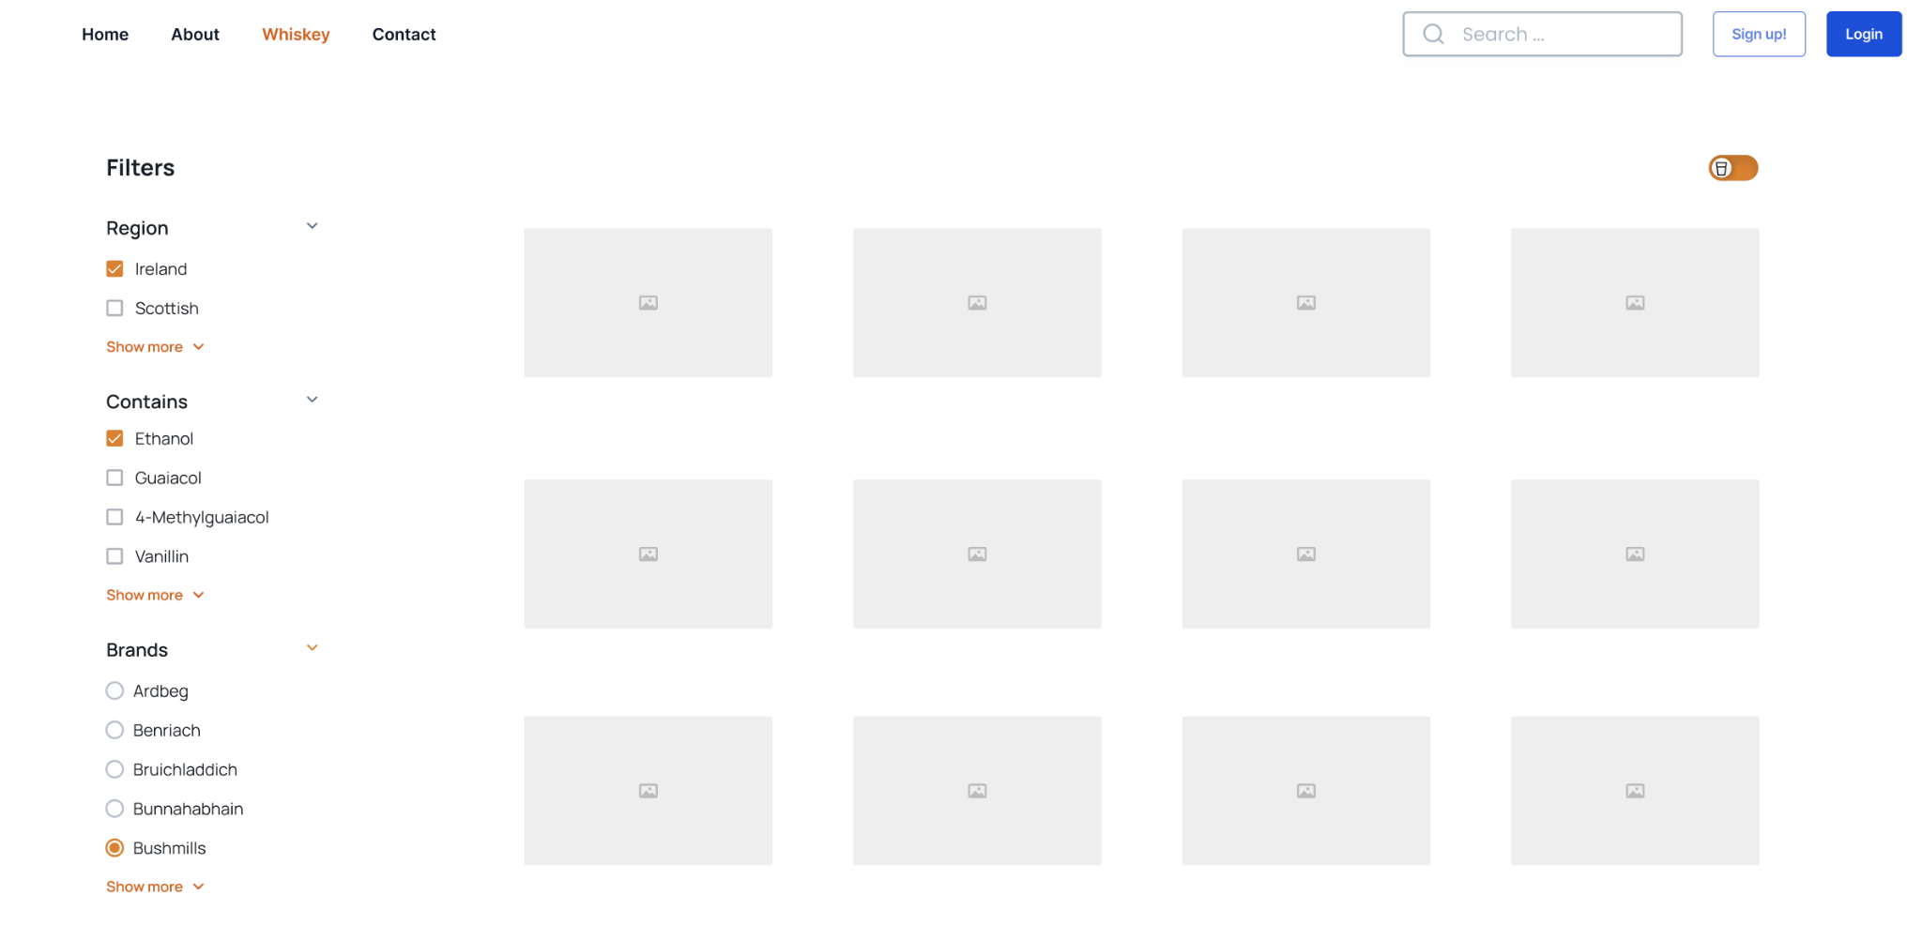
Whiskey/flavour page
PC
Navigation Bar
Filter
product content

Slide 11
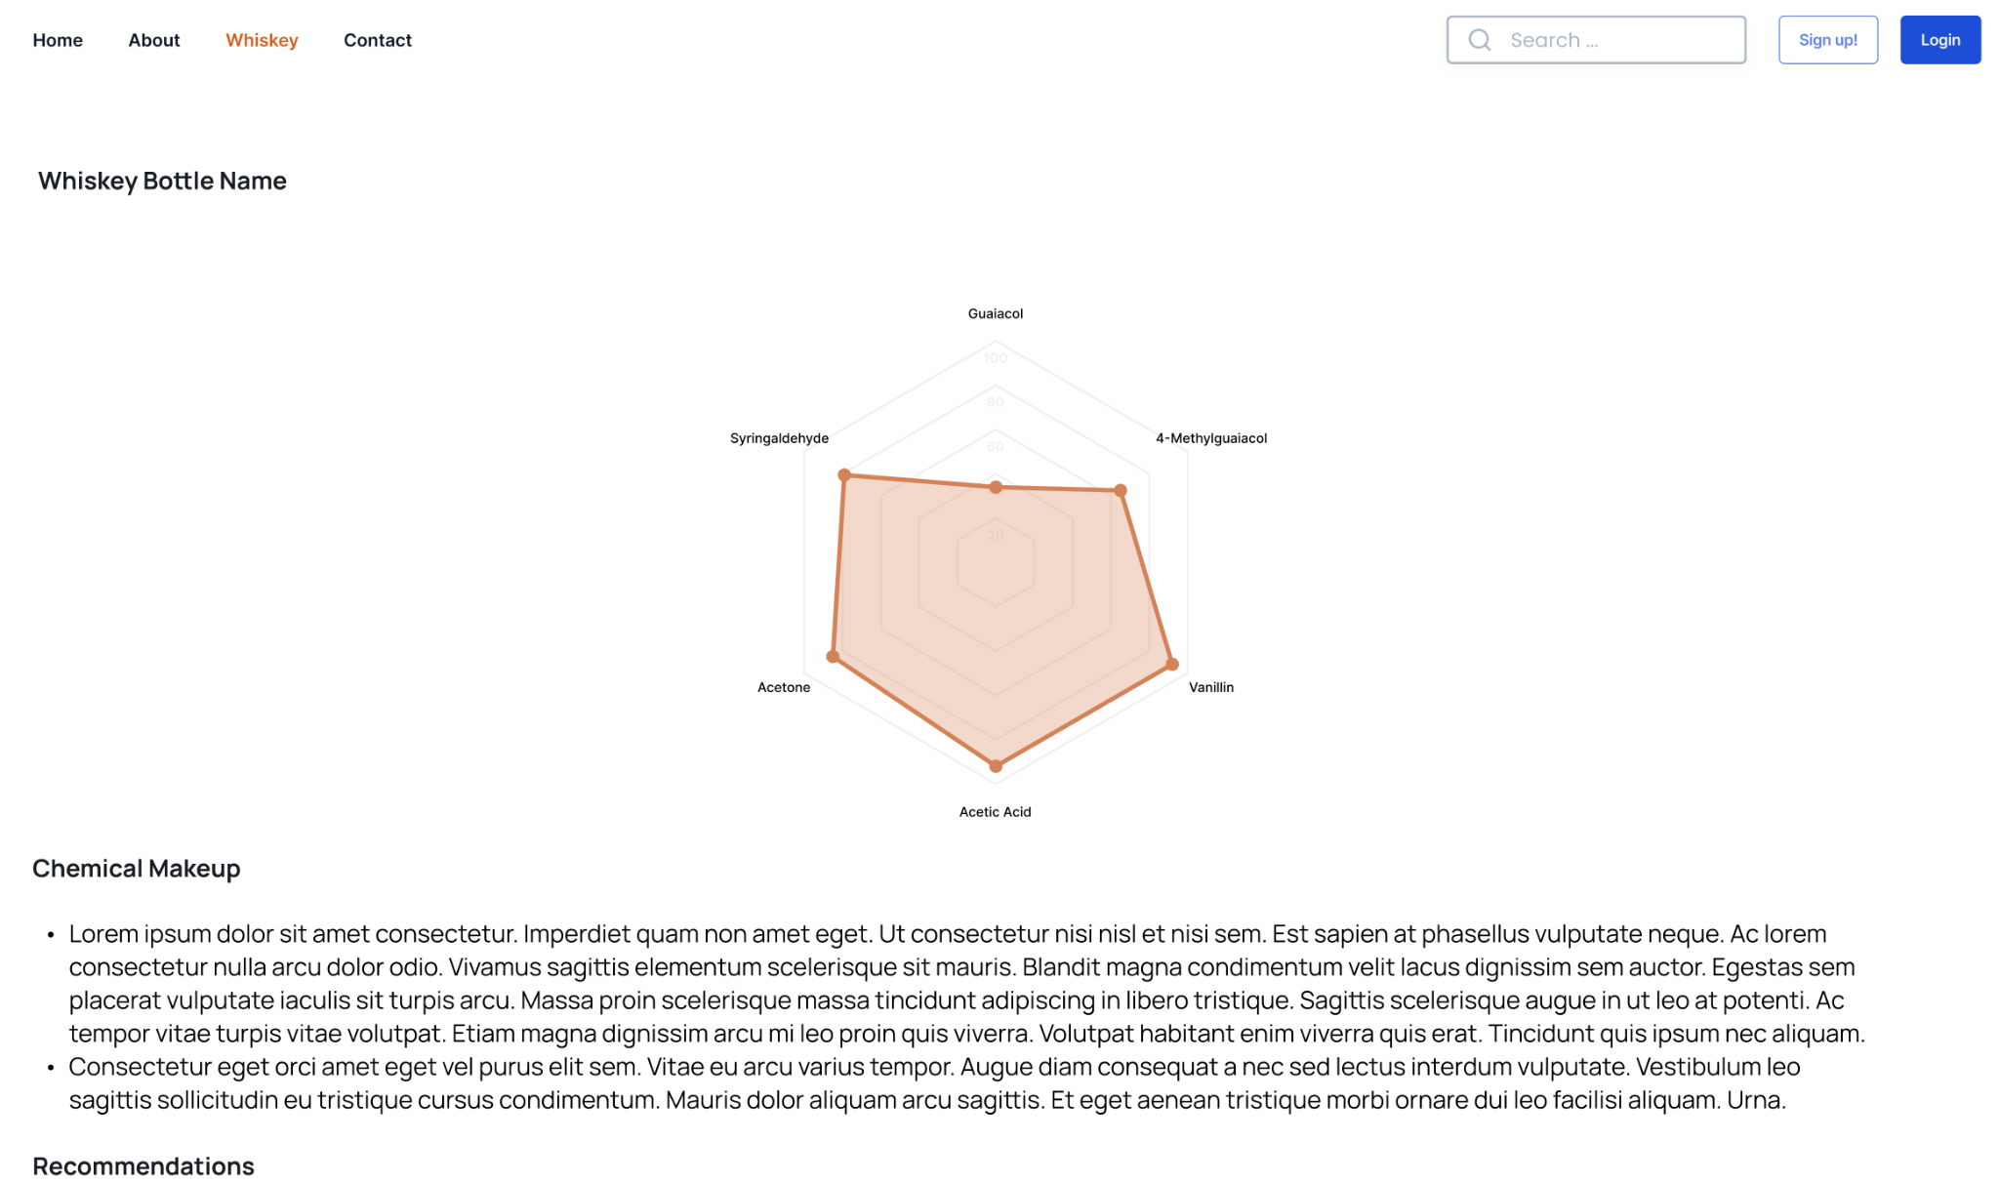
Bottle page
Zhineng Gu

Slide 12
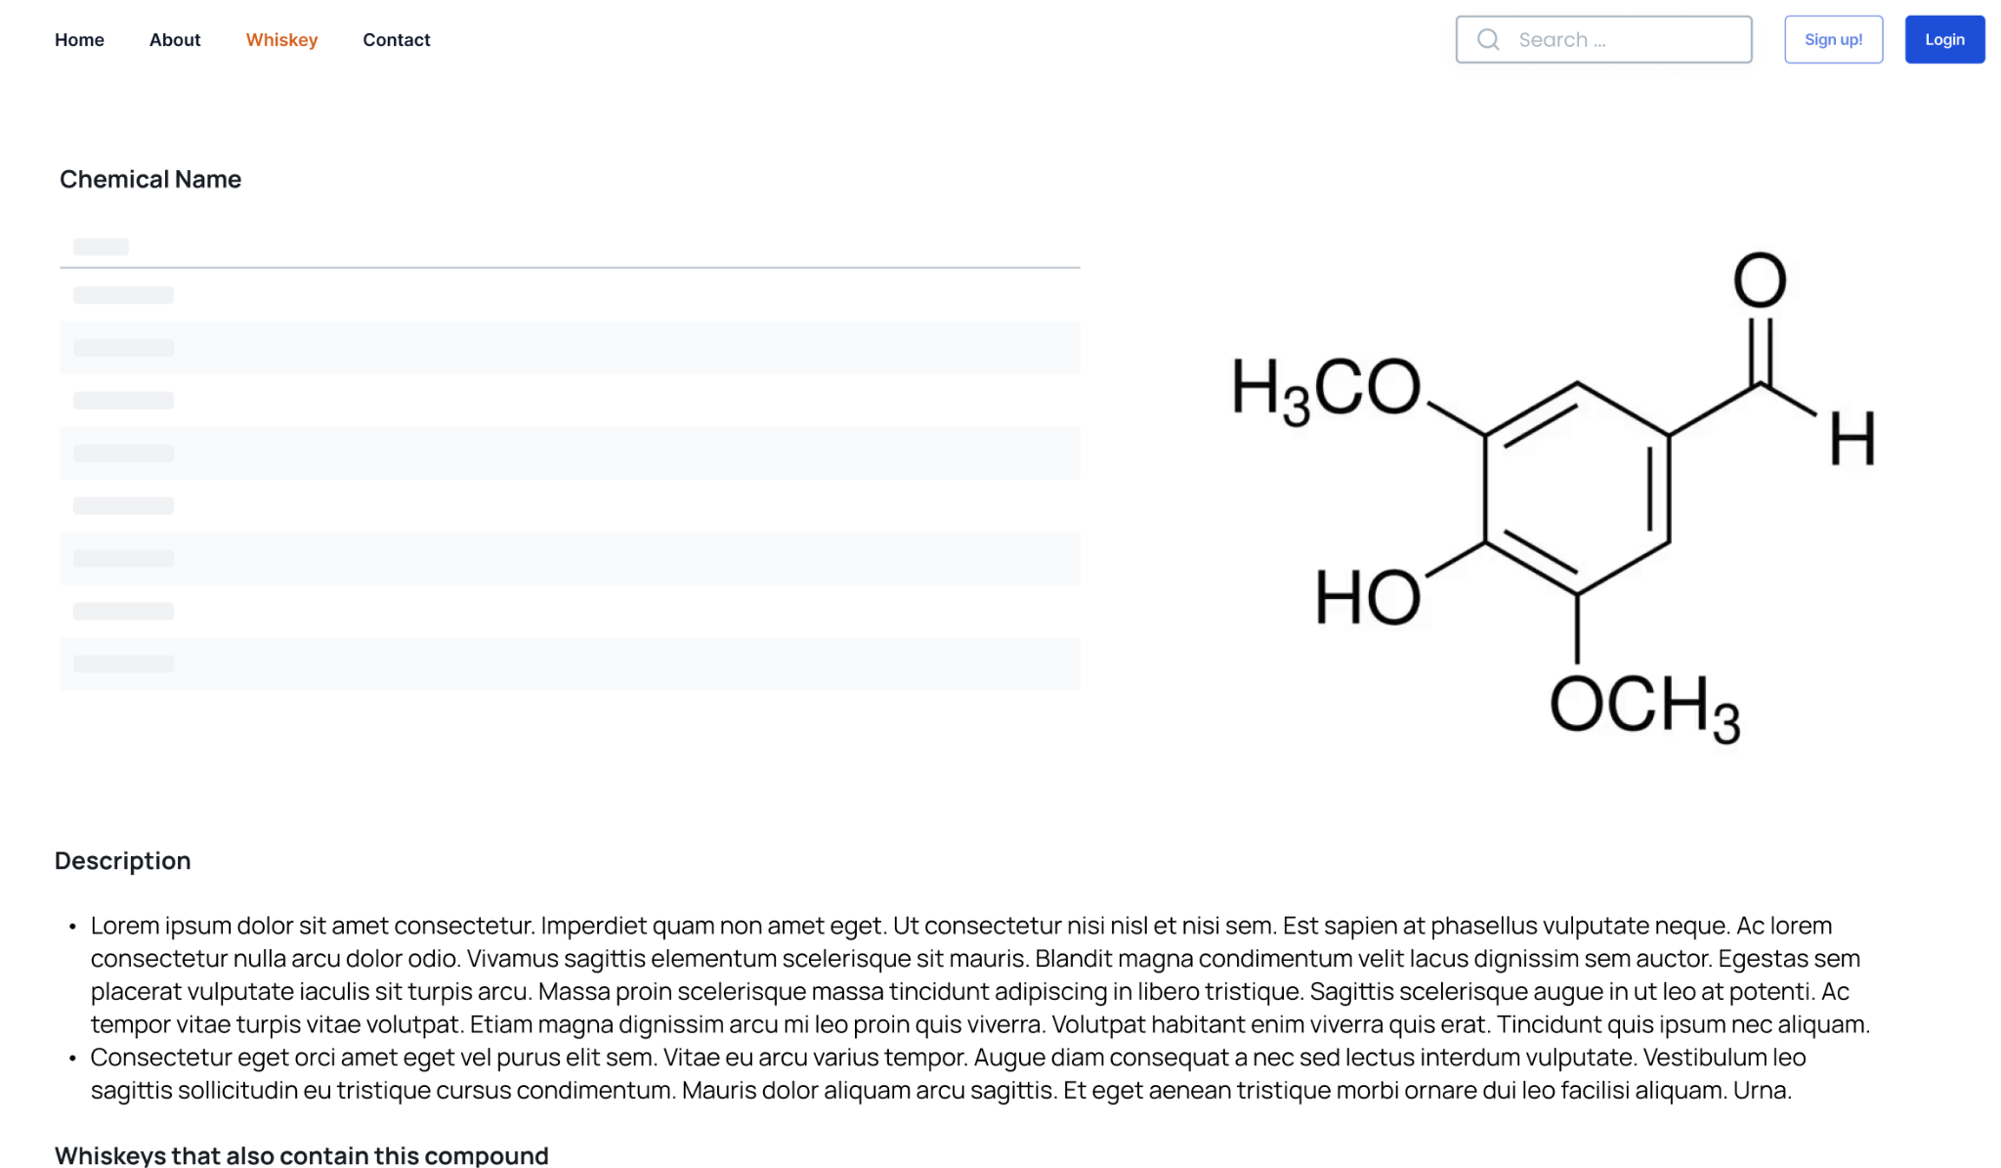
Compound/flavour page
Jiahui

Slide 13
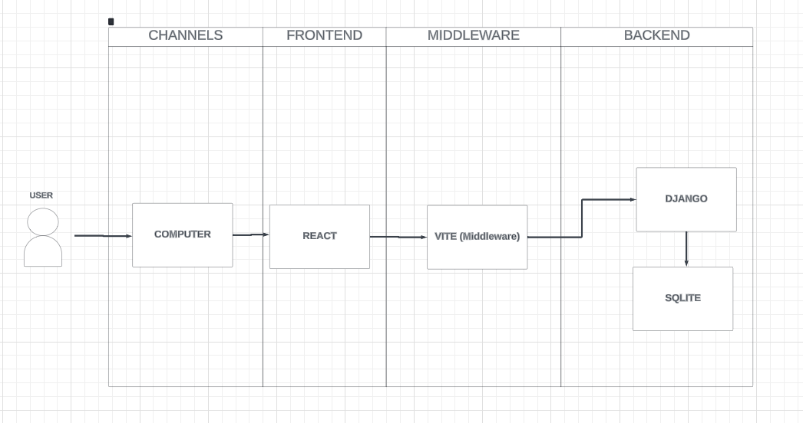
Solutions architecture
NICK

Slide 14
Demonstration

